Slide 1


Workday Concepts & Time
Supervisors of Hourly Workers (Non-Shift)

Slide 2







What’s Up With Workday?
Workday’s simple, easy-to use system is available 24/7 via your computer or mobile device. With Workday you can:
Check your pay and W2s
Check your benefits
Update your info
See your co-worker’s schedule
Ask for time off
Manage your team
Clock (Check) in and out
Notes:
Workday is a simple, easy-to use system and is available 24/7 via your computer or mobile device. With Workday employees will be able to update their personal information, see coworkers, clock in and out, request time off, and check their pay, W-2s, and benefits.

Slide 3
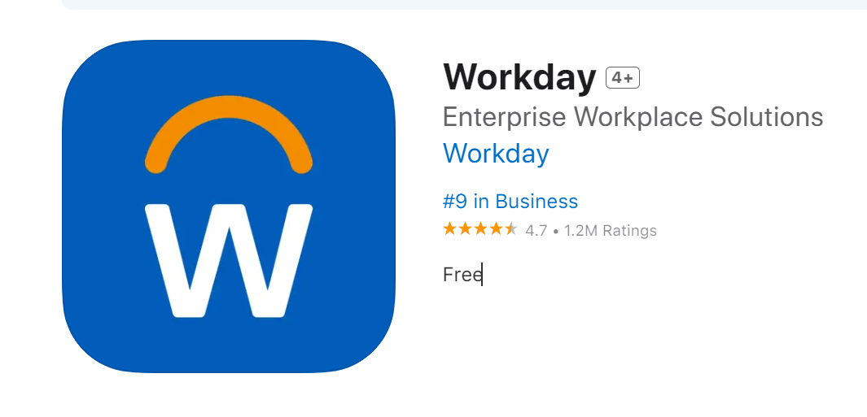
Login to Workday – Available September 15th
On the Network
The new link will be available on Monument Connect
Once you click the link, you will be directed to the home page. You’re in!​
Off the Network
You will need to authenticate through Microsoft Authenticator
Mobile App
Company email and password
Notes:
Workday is a simple, easy-to use system and is available 24/7 via your computer or mobile device. With Workday employees will be able to update their personal information, see coworkers, clock in and out, request time off, and check their pay, W-2s, and benefits.

Slide 4
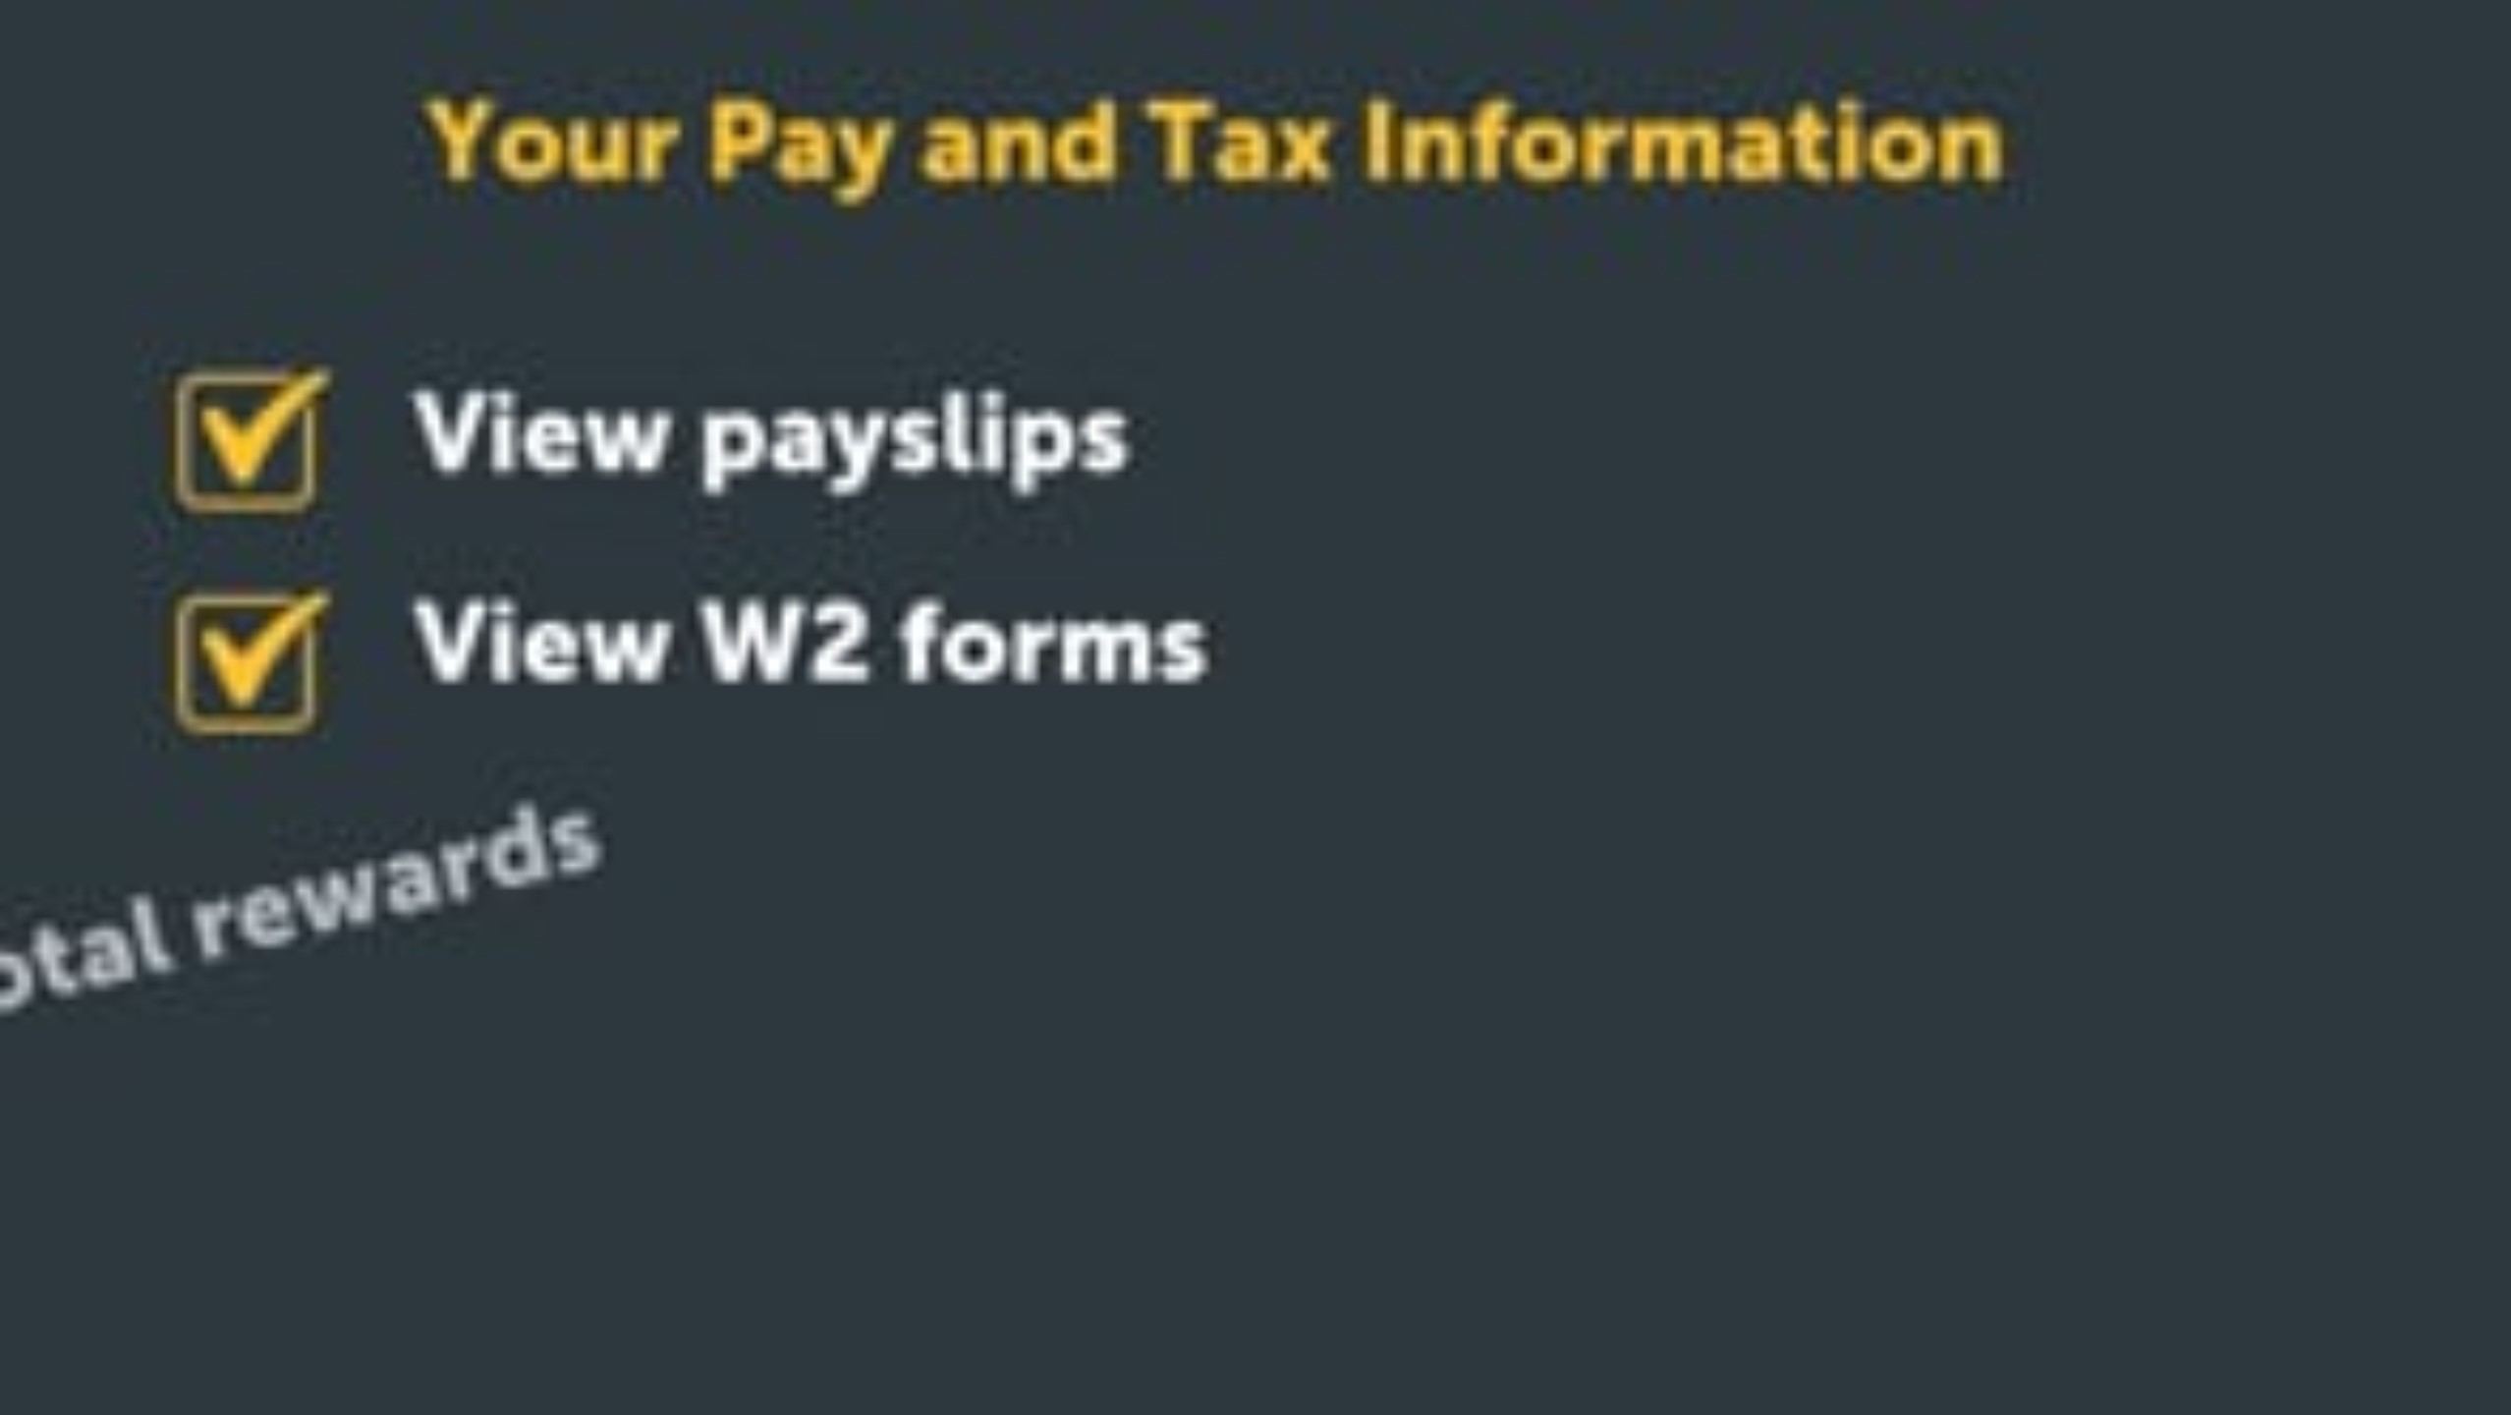
Notes:
Video to review pay & tax information

Slide 5
Pay Information - “Payslips” (Paystubs)
October 3rd will be the first pay date in the system
Paystubs prior to October 3rd will only be stored in Employee Self Service (ESS)
Print your paystubs in ESS before September 15th
If you need ESS paystubs after October 11th, you will need to submit a request through HRSS

Slide 6
Managing Employee’s Time

Slide 7
Workday replacing TimeClock Plus
Employees: Clock in/out, Submit timesheets weekly & submit time off requests
Supervisor: Review, approve timesheets weekly & submit time off requests, fix missed punches
Production Specialist/Day Supervisor: Approve time off requests & timesheet approver back up
*if you will be out, delegate to other STL/FP or Tracy will be default backup
Phase 2, Advanced Scheduling: Generates schedules based on fixed shift, patterns and assigns workers to shifts based on worker availability, preferences, and qualifications.

Slide 8

Notes:
Video to come!

Slide 9
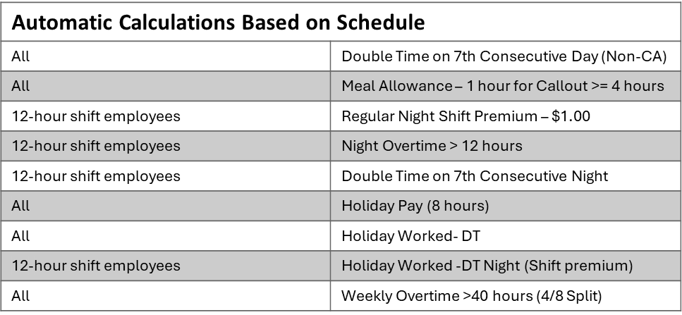
Timeclocks
9/3 – 9/13: Fingerprint enrollment the biometric reader
9/16 – Clocks will be mounted, morning shift will be manually entered into Workday
All hourly will clock-in and out
Employees should clock-in based on Shift team norm times
Schedule Driven Automations:
Schedules and calculations have been built based on Shift Team Norms
Anything outside of the schedule will be calculated as OT

Slide 10
Managing Your Team

Slide 11

Notes:
How to Manage Your Team.mp4

Slide 12
Managing Team Compensation

Slide 13
Confidentiality is KEY
While Workday provides you with more employee information to help make you day-to-day job easier, and make informed decisions for your team, keeping employee information safe is your job. It is your responsibility to:
  Keep all non-public business information confidential as described in the Code of Business Conduct
  View and use employee data only as needed, for legitimate business purposes like compensation planning or discussions (Never for person gain or for non-business purposes)
Notes:
To begin, we want to emphasize that confidentiality is key around personal information, including pay, in Workday.
For the first time, you will see both pay and benefits for yourself and your team all in one place in Workday. You can see salary, bonuses, benefits, and other forms of pay all together. This helps you make good decisions about pay and see how much your team is rewarded.
It's important to know that while you have access to this information, you must follow privacy rules. Only look at pay information for real work reasons and keep all employee data secret. Misusing this information can lead disciplinary action, On Day 1, September 15th, you will need to get familiar with the pay dashboard and make sure you know how to use it correctly. By using these pay features in Workday, you can manage your team's pay well and keep all information correct. If you have any questions or need help, don't hesitate to ask.

Slide 14



Where To Get Help
Your HR Team
Employee Hub @ 800-303-0408 or EmployeeHub@thgrp.com
Help Center in Workday

