Slide 1


Workday Concepts & Time
Hourly Workers - KY

Slide 2






What’s Up With Workday?
Workday’s simple, easy-to use system is available 24/7 via your computer or mobile device. With Workday you can:
Check your pay and W2s
Check your benefits
Update your info
See your co-worker’s schedule
Ask for time off
Clock (Check) in and out
Notes:
Workday is a simple, easy-to use system and is available 24/7 via your computer or mobile device. With Workday employees will be able to update their personal information, see coworkers, clock in and out, request time off, and check their pay, W-2s, and benefits.

Slide 3
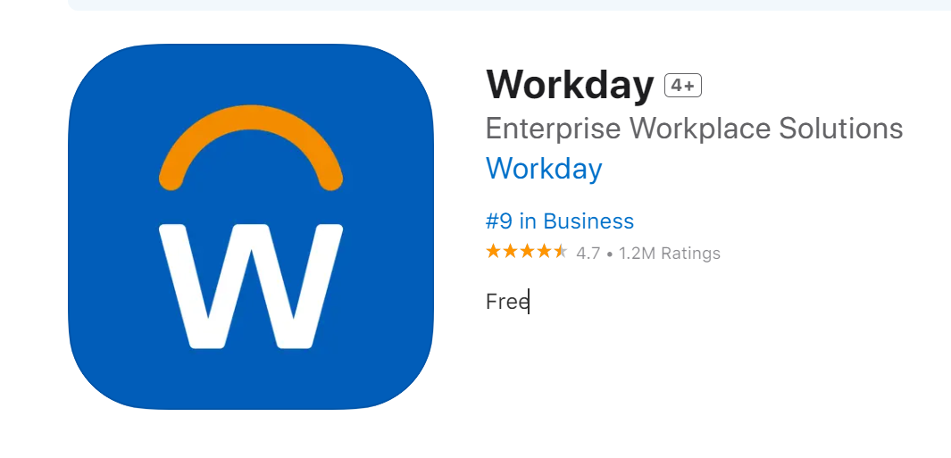
Login to Workday – Available September 15th
On the Network
The new link will be available on Monument Connect
Once you click the link, you will be directed to the home page. You’re in!​
Off the Network
You will need to authenticate through Microsoft Authenticator
Mobile App
Company email and password
Notes:
Workday is a simple, easy-to use system and is available 24/7 via your computer or mobile device. With Workday employees will be able to update their personal information, see coworkers, clock in and out, request time off, and check their pay, W-2s, and benefits.

Slide 4
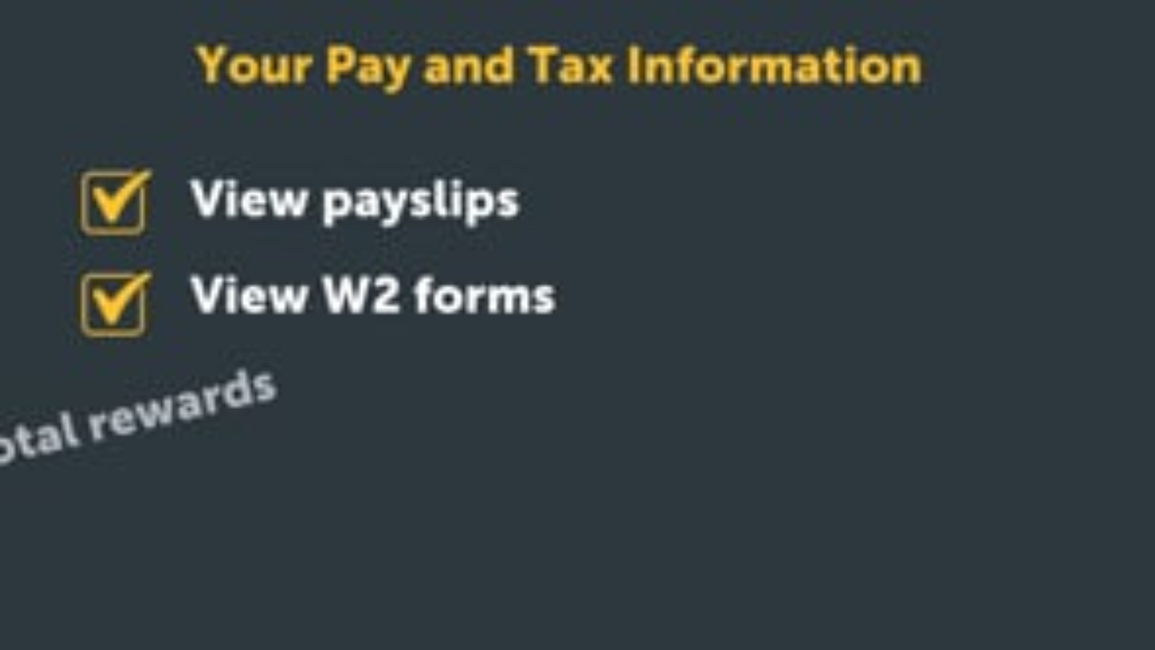
Notes:
Video to review pay & tax information

Slide 5
Pay Information - “Payslips” (Paystubs)
October 3rd will be the first pay date in the system
Paystubs prior to October 3rd will only be stored in Employee Self Service (ESS)
If you need ESS paystubs after October 11th, you will need to submit a request through HRSS

Slide 6
Time Management

Slide 7




Time Management Workflow
By default, all those with Manager roles can manage timecards for the people on their team. Managers/Supervisors can delegate to other people to manage time in their absence as needed, up to 30 days (over 30 days requires manager approval).
Employee Check In/Out for Start/End
Employee Submits Timecard on last day worked in week
Manager Approves Timecard by the following Monday 10am EST (Tuesday 10am EST if a holiday falls on payroll week)
Payroll processes
If Check In / Out is missed or inaccurate, employee must contact Manager/Supervisor to correct
If employee fails to submit timecard, it cannot be approved. If needed, Manager/Supervisor can submit timecard on employee’s behalf
If manager does not approve timecard, pay may be impacted
Manager/Supervisor adds/updates missed Check-In
Manager/Supervisor Submits Timecard
HR will monitor
Notes:
The time management workflow in Workday starts with checking in and out at the start and end of your work shifts and breaks.
At the end of the week, you’ll submit your timecards for approval. A timecard has to be submitted before it can be approved. This should be done by you, the employee, but managers and supervisors can do it when needed.
As shared, managers will approve these timecards by the following Monday at 10 am EST, or Tuesday at 10 am EST if there is a holiday. After they approve the timecards, payroll processes them to ensure employees are paid correctly. If any check-ins are missed or incorrect, the employee needs to contact their manager to fix them. This process helps ensure that all work hours are accurately recorded and that payroll runs smoothly.

Slide 8

Your Role in Timecards
Enter time in/out for each shift at the beginning or end of shift.
Instead of blocks of time, you will enter time in & out rounded to the nearest 15 min.
You will no longer have to break out each job code. Rules are built into the system to calculate overtime, double time, etc.
Speak to your supervisor when there is a missed/inaccurate time in/out
Submit timecard for approval at the end of each week
Notes:
This slide summarizes the role of an hourly worker around time management – you will…
Check in at the beginning of each shift and out at the end of each shift. You’ll also have to check out and back in around meal breaks.
If you ever need to adjust an inaccurate check in / check out, you will need to reach out to your manager or supervisor. Managers / supervisors are then able to fix on your behalf to avoid any disruption to your next paycheck!
And third, you will need to submit your timecard for approval at the end of each work week. Doing this sends the right information onto payroll.

Slide 9

Notes:
Video that reviews the timecard submit process

Slide 10
Absence Management

Slide 11
Absence Types in Workday
Time Off
What is it: short breaks (hours or days)
Example: Taking a vacation, staying home when you are sick, having a day off for personal reasons
Leave of Absence (LOA)
What is it: Asking for a longer period off work
Example: Taking time off for a serious medical condition, maternity or paternity leave, or personal matters that need more time and are approved

Slide 12


Slide 13



Where To Get Help
Your HR Team
Employee Hub @ 800-303-0408 or EmployeeHub@thgrp.com
Help Center in Workday

